Slide 1
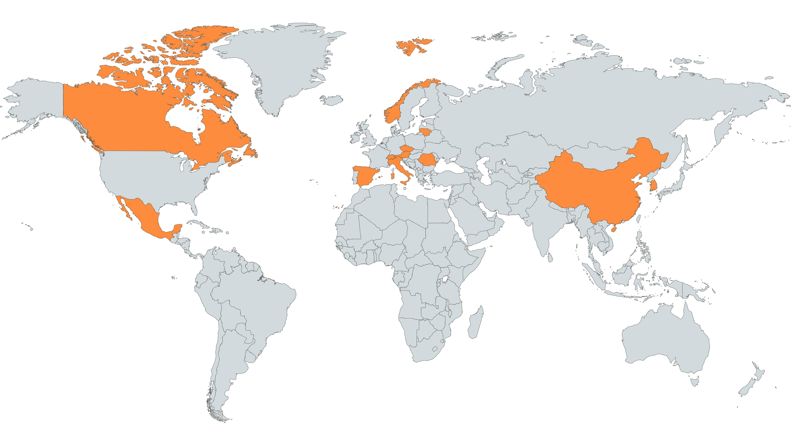

5th year (2018)
14
12
17
6
2
PhD
MSc
Other

